Slide 1

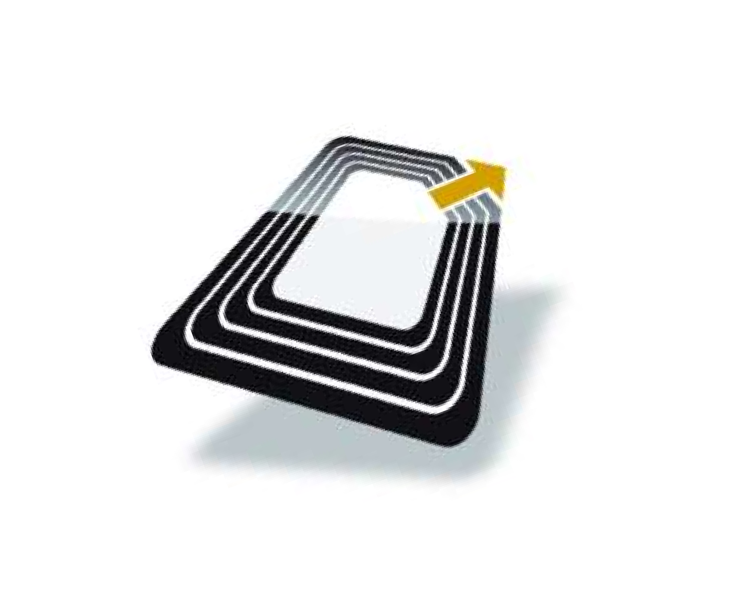
RFID BASED ATTENDANCE SYSTEM
By:-
Surya Saini (430)
Manan Aggarwal (414)
Dhanuj Kumar Sharma (004)

Slide 2
INDEX
RFID
Description
Working
Hardware Used
Types
Applications
RFID VS Barcodes
RFID based attendance system
Schematic Diagram
Working

Slide 3
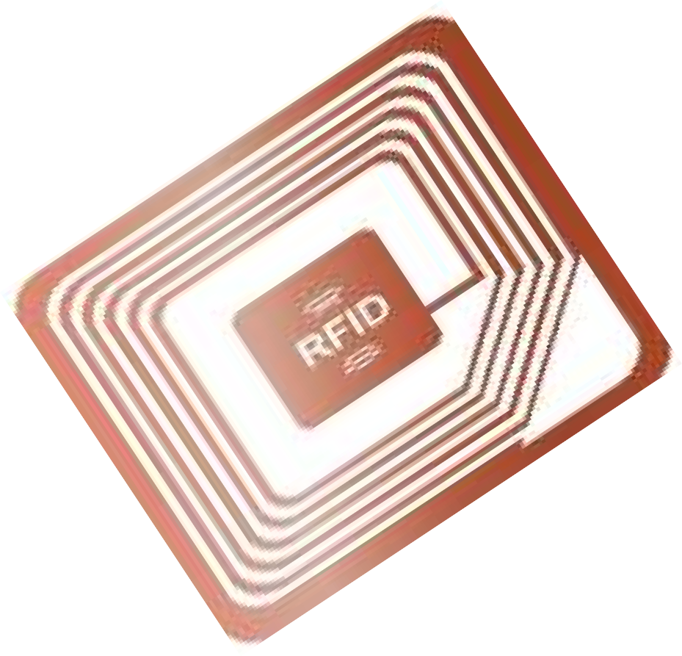
Description
RFID is an acronym for radio frequency identification.
RFID is a member of automatic identification and data (AIDC) technologies and is fast and reliable means of identifying just about any material object.
Active RFID tags are powered by an internal battery and are typically read/write i.e. tag can be rewritten and/or modified. An active tag’s memory size varies according to application requirements.

Slide 4
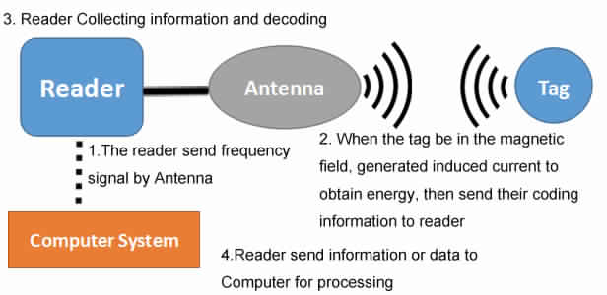
WORKING OF RFID
Tags (or chips) consist of two parts:
Antenna
Processor/ Storage
Receives signal from reader and gives a return signal with ID number
Reader sends the ID to the database (computer system).

Slide 5
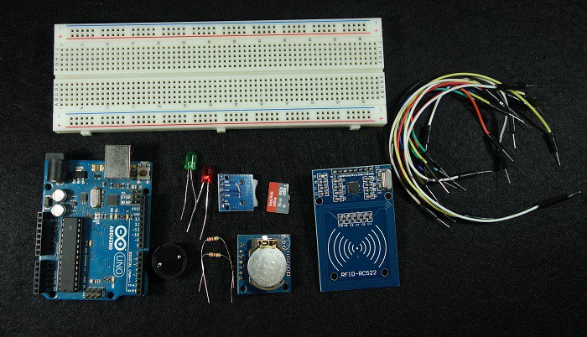
Hardware Used

Slide 6
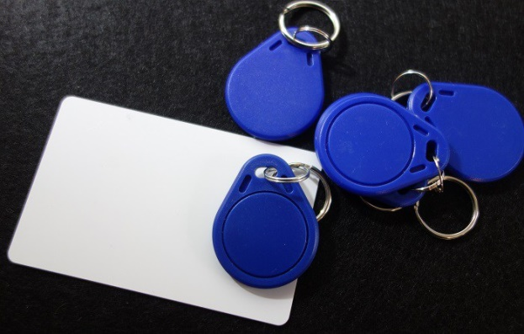
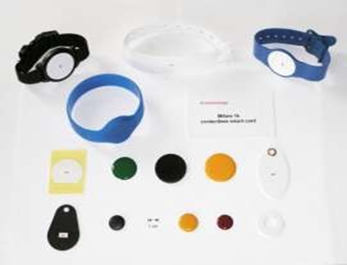
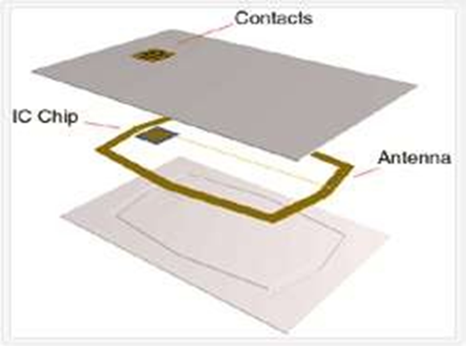
RFID Tags

Slide 7
TYPES
ACTIVE:
Tag signal availability of 100ft.
HIGH signal strength
example: Railway cars on a track
PASSIVE:
Tag signal availability < 10 ft.
VERY LOW signal strength
Widely used because very cheap to make

Slide 8
APPLICATIONS
Advanced Product Tracking
Real- time data management
Dramatic benefits to manufacturing process
Quick Convenience
Grocery Store, Library, Hospital Instant identification, Time saver
Safety and Security
Locate/identify missing persons Monitor prisoners
Easy Access
Access by authorized personnel only Ease security concerns

Slide 9

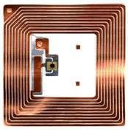
RFID vs Bar Codes
Does not require human to manually pass item over scanner.
More accurate inventory count.
Can be incorporated into product, person, animal.
Can track each individual item.

Slide 10
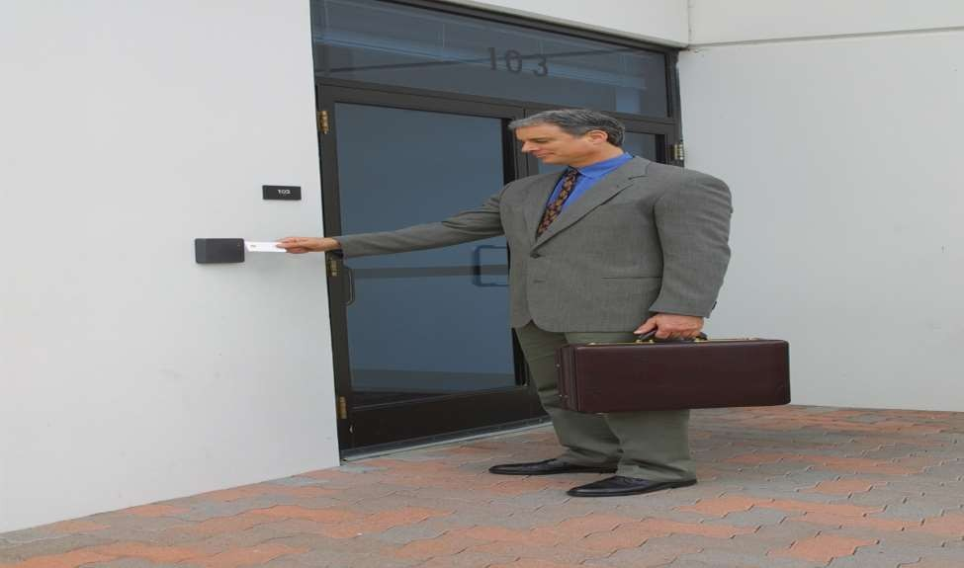
RFID BASED ATTENDANCE SYSTEM

Slide 11
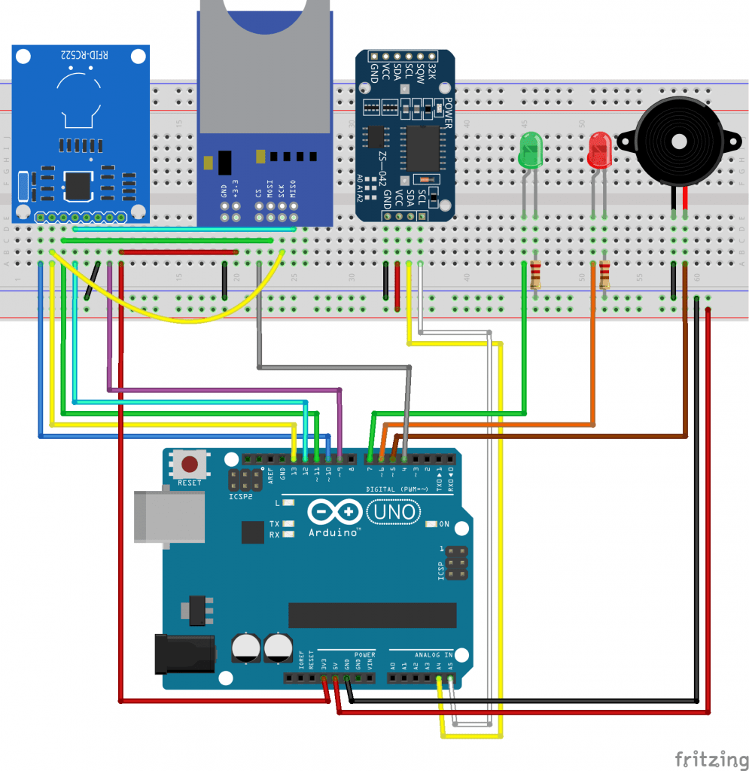

SCHEMATIC DIAGRAM

Slide 12

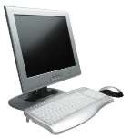




Working
RFID card is detected by the reader module if it in the range of 10 cm.
After reading the card it checks the database.
After checking database it decides that card is duplicate or not.
According to database it controller increases the count for that specific lecture and store it in database

Slide 13
Conclusions
This project is a full system for student monitoring in colleges, and high education institutes.
The device is supported with friendly using software for data analysis and previewing .
Lecturers need no more wasting time, and effort to have their attendance register .
Attendance register can be easily uploaded to the database.

Slide 14
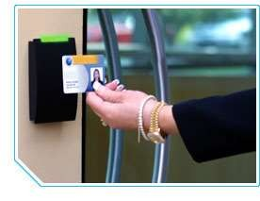
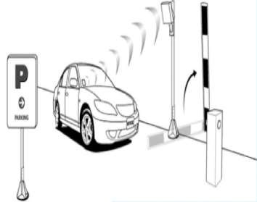
APPLICATIONS
Employee attendance
Parking

Slide 15
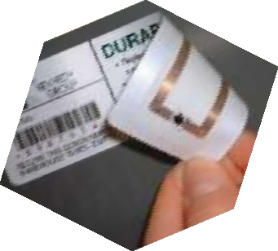
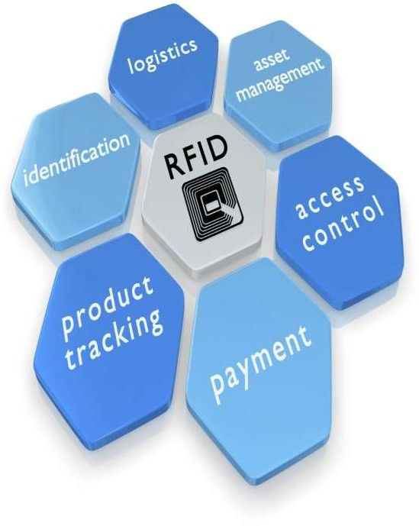
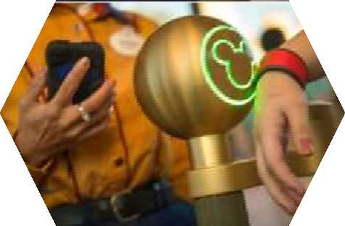
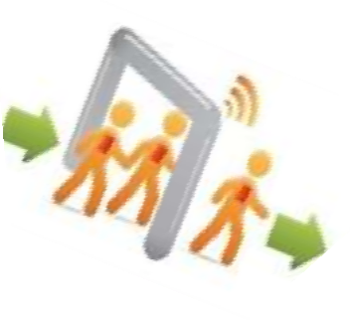
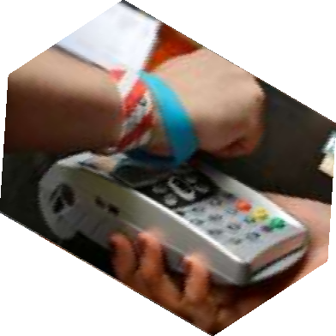
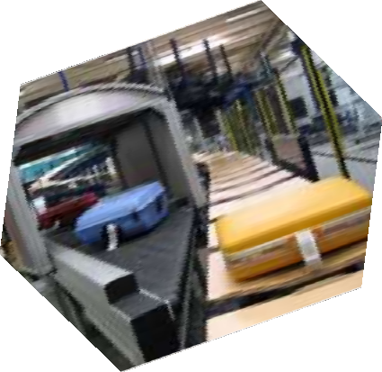

Slide 16


